Slide 1
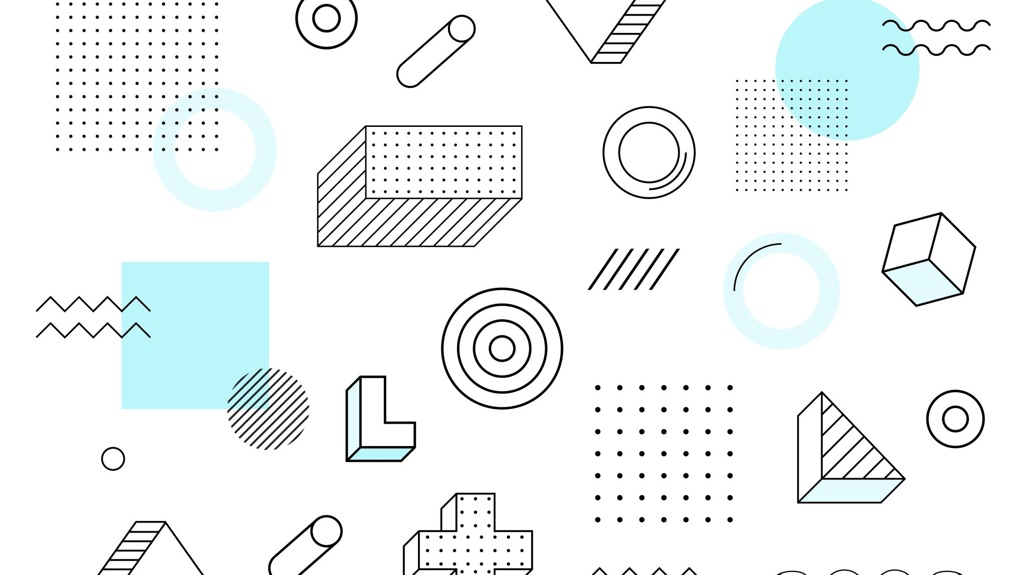
The Making of A Digital Card Game
By: Aaron Handjojo
Faculty Advisor: William Erdly

Slide 2
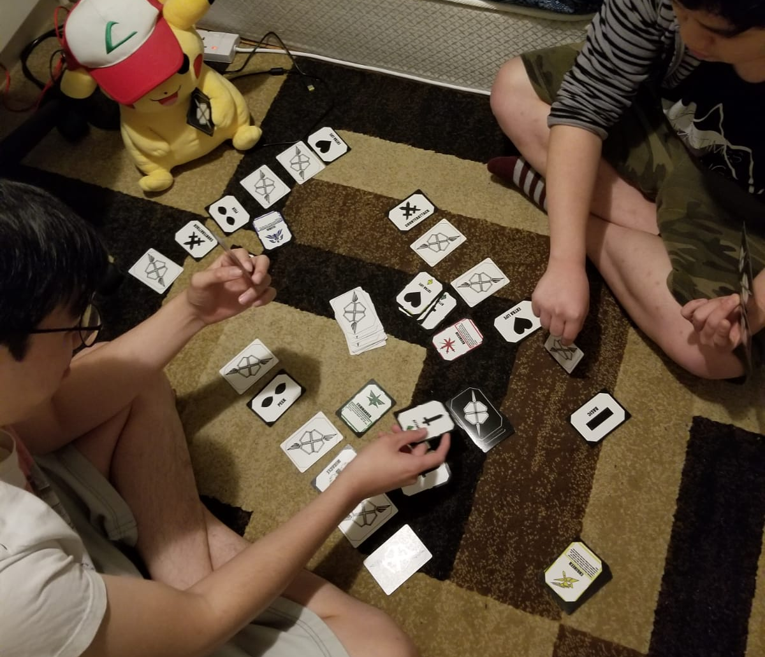
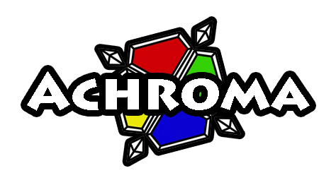
Context –Developing a Card Game
Notes:
Achroma is a tabletop card game I developed in High School
The idea sprung out of nowhere ->
The game started out as

Slide 3
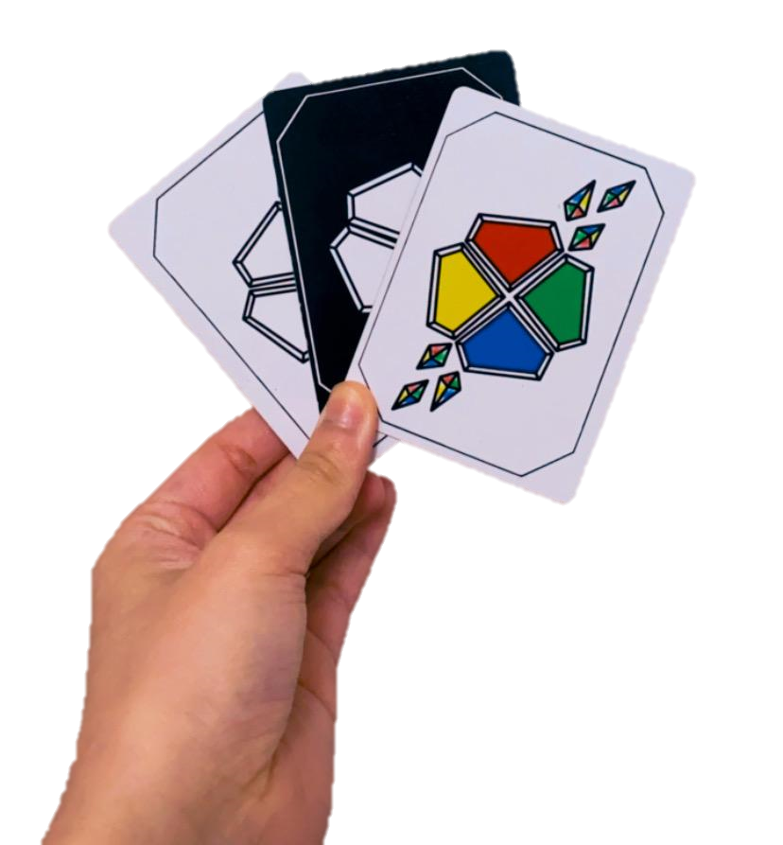
Context –Developing a Card Game
Created in high school
Players become “characters” in the game with special abilities.
They fight one another until one becomes victorious.
They do this using “actions” provided to them in the form of cards.
Notes:
Achroma is a tabletop card game I developed in High School
The idea sprung out of nowhere ->
The game started out as

Slide 4
Objective – Digital Conversion
Goals:
Polish the game in terms of balance and “fun”
Develop a working 3D digital version of the game which includes:
Cards that will work as they do in real life
UI that is clear and helps the player understand what to do
A responsive AI to play as the opponent

Slide 5




Tools
Unity (Game Engine)
Visual Studio (C# IDE)
Paint Tool SAI (Game Art)
GitHub (Version Control)

Slide 6
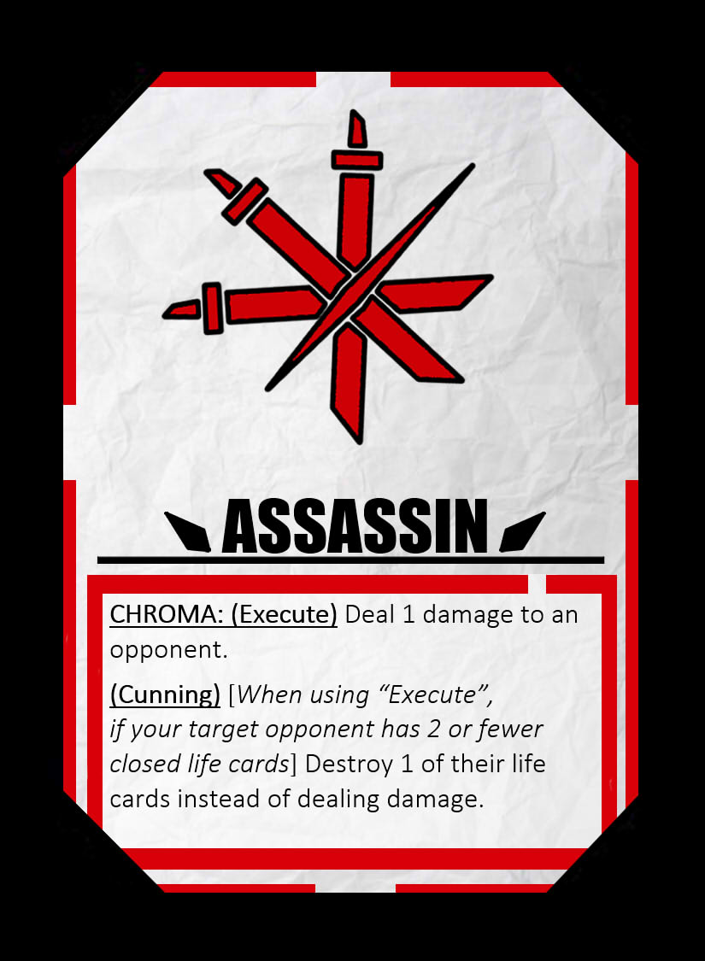
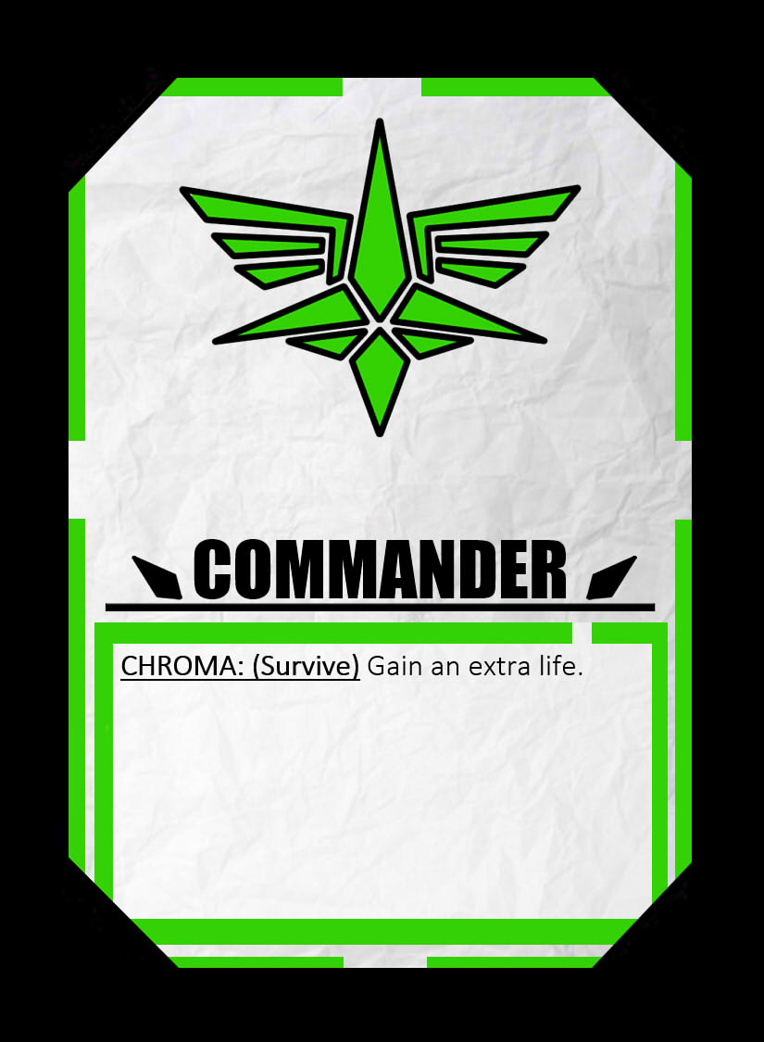
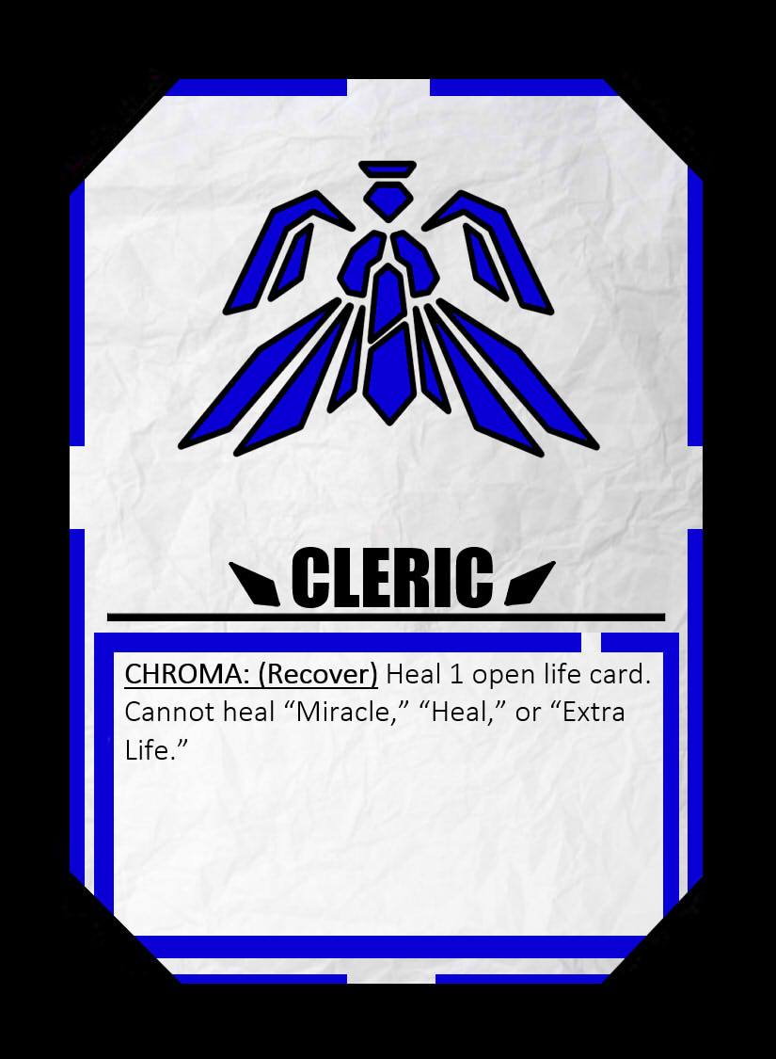
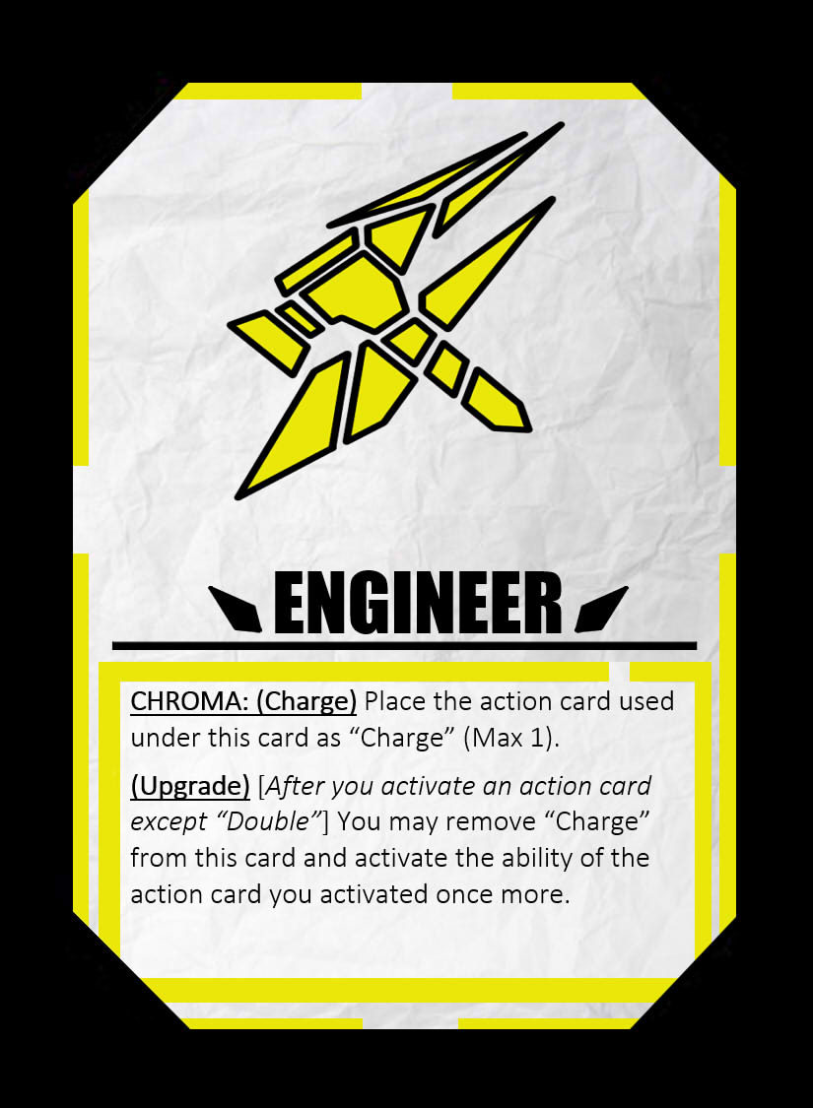
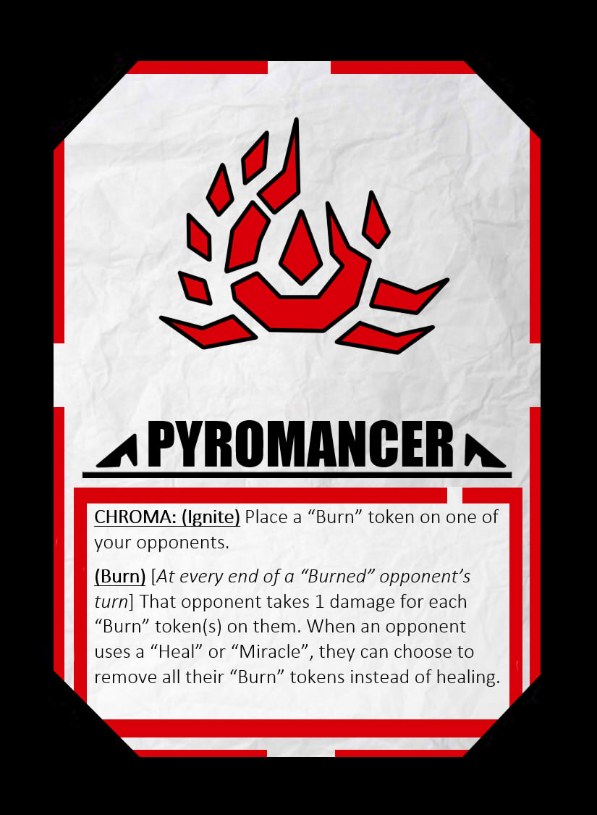
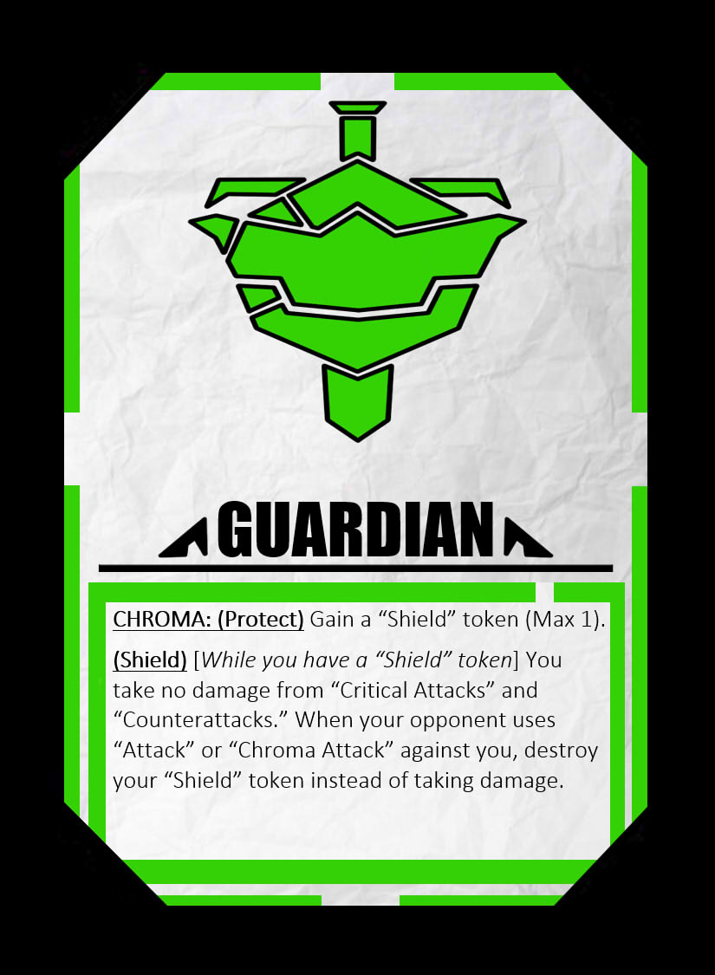
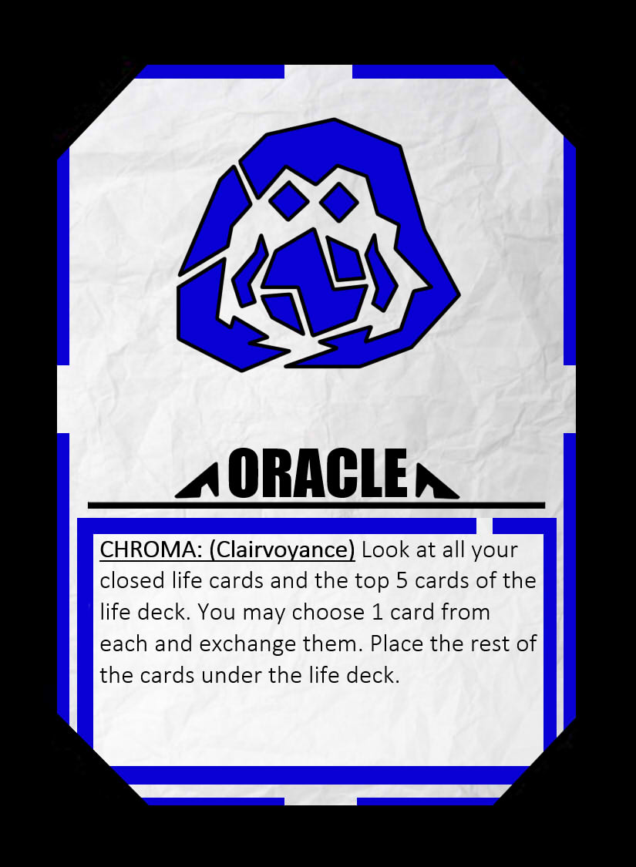
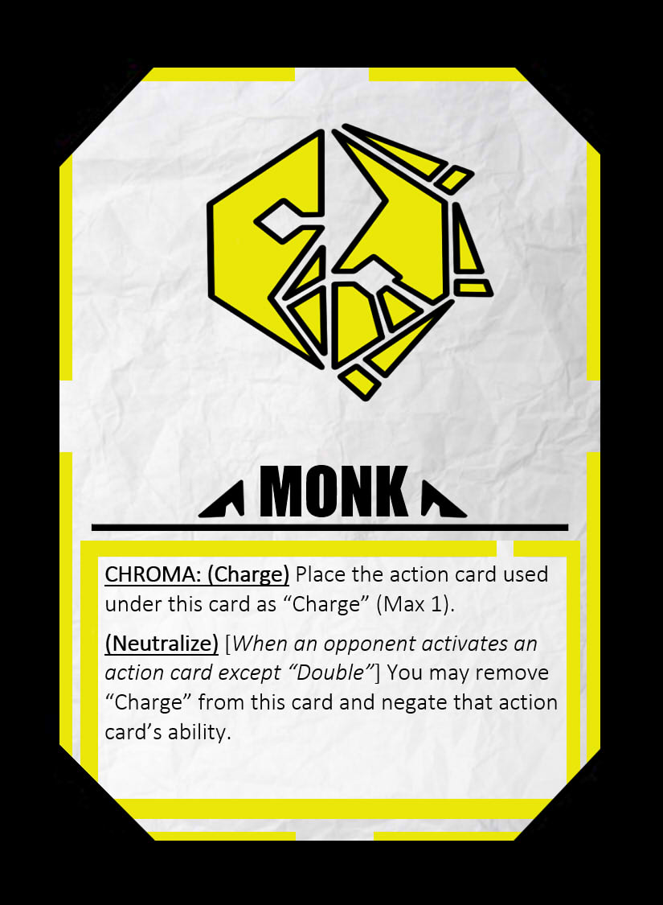
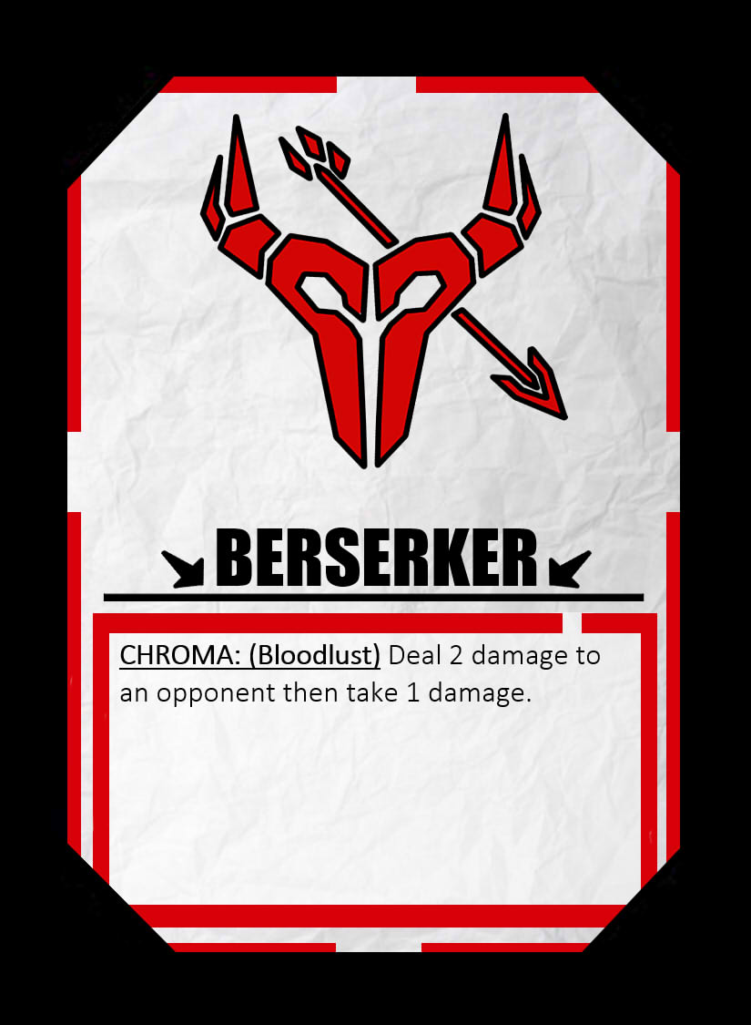
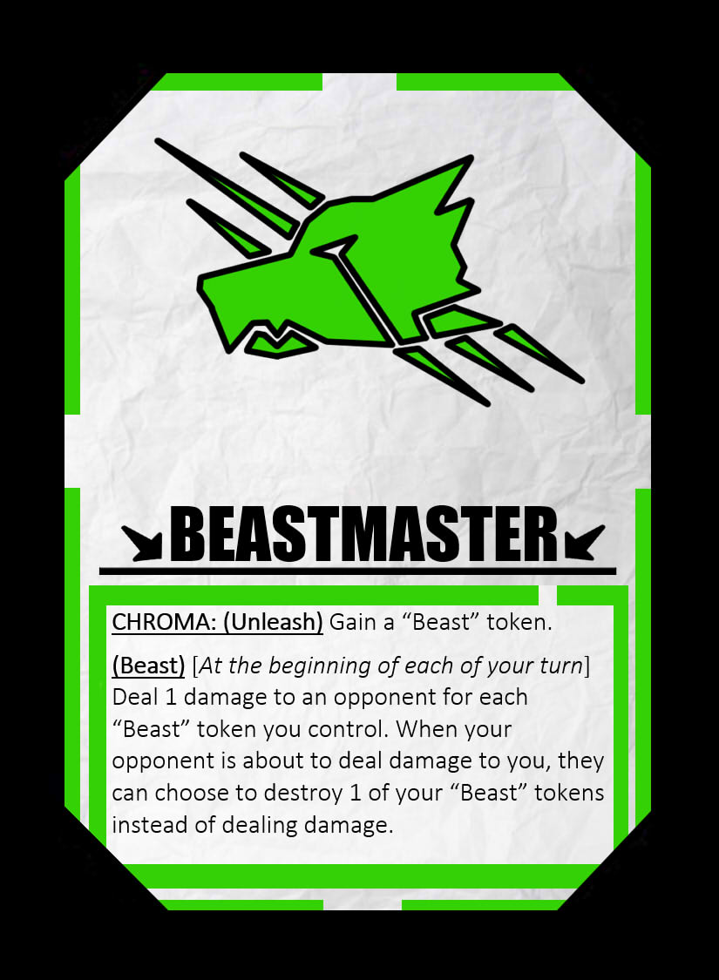
Game Development – Player Experience
Player Experience → Battling/Strategizing
Each “Character Card” enables a different player experience:

Slide 7
Game Development – Elemental Tetrad
Mechanics:
- Strategy battle card game
Story:
- The player is transported into another dimension where they are granted special powers and forced to battle others trapped in the mysterious “Chroma World”
Aesthetics:
Colorful Space
Static/Simple art style
Technology:
- Computer/Android

Slide 8
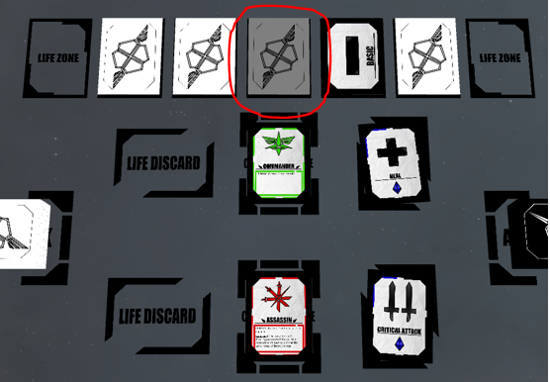
Game Development – Visual and Audio Queues
Visuals must clearly indicate what the player can and cannot interact with.
Audio must match the situation and event to immerse the player into the game.

Slide 9
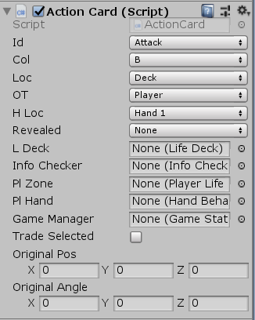
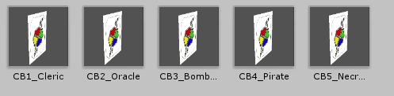
Software Development – Game Objects
Every card is an object with:
Identity
State (Active, Inactive)
Location (Hand, Deck, etc)
Owner (Player or Enemy)

Slide 10
Software Development – Turn State Machine
The game’s “Main Component” is a state machine that controls the flow of the game.
- Since the game is a turn-based card game, the game simply needs to prompt the user of what they want to do depending on the phase of the game.

Slide 11
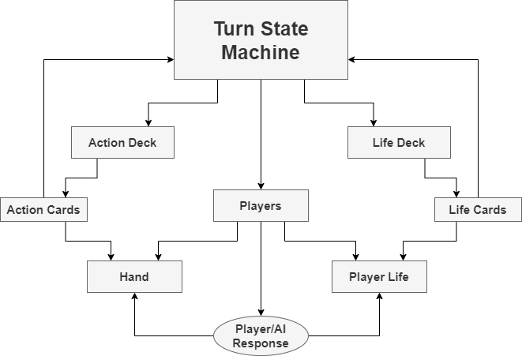
Software Development – Simplified Architecture

Slide 12
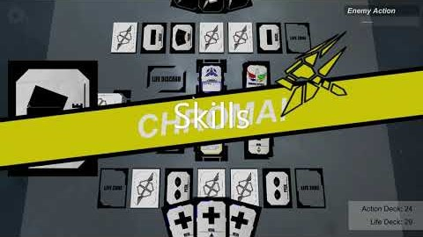
Digital Game

Slide 13
What I Learned
Balancing and developing games through the perspective of the elemental tetrad and player experience
Game development with Unity
Video game architecture
UI design

Slide 14
Next Steps
Polish Animations
PvP development
Tutorial Scene
Online Play

Slide 15
Related Courses
CSS490 – Interactive Game Design: Game development mainly focusing on what makes a game good such as the elemental tetrad and player experience.
CSS385 – Intro to Game Design: Game development with Unity and how to develop the right architecture for video games.
CSS342 & CSS343 – Algorithms: Effective algorithms to use when coding.

Slide 16
Acknowledgements
A very special thank you to Dr. Erdly for approving and guiding my personal project. I learned a lot about making games properly from him.
Thank you to Professor Sung for teaching me to use Unity and the best ways to structure games in a software development standpoint.
And thank you to Professor Kool for helping me with the aesthetics and grammar of the game.

Slide 17
Q&A
Any Questions?

